Slide 1

Sports Buddy: Project Report
Sports Buddy connects enthusiasts. It facilitates sports event participation. It
creates meaningful social interactions. The app leverages Visual Studio codetechnology.
Our goal is the world's largest sports matching platform.

Slide 2

Project Objectives
1
Create Matching Platform
Develop a comprehensive platform for sports enthusiasts.
2
3
4
Discover Events
Enable users to find and join local sports events.
Facilitate Networking
Create social connections through shared sports interests.
User-Friendly Interface
Provide an intuitive and easy-to-use design.

Slide 3
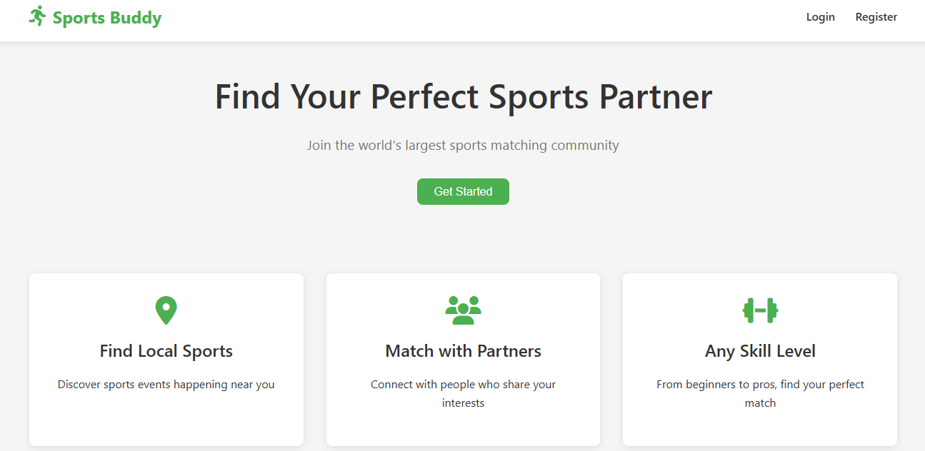
Key Features
User
Registration
Event
Discovery
Skill
Matching
Location
Search
The app features user registration and event management. Skill level
matching is a core feature. Location-based search enhances user experience.
Social networking connects users.

Slide 4

System Architecture: Modules
User Module
Admin Module
Registration (email/social)
Secure login
Secure login
Sports category management
Add, update, and remove categories
Location management
Profile access
Personalized recommendations
Sports event management
City, area administration

Slide 5

Technology Stack
Platform
Language
Visual studio code
HTML, CSS, Javascript
Database
Geolocation
Firebase console
Google Maps API
The app uses the Visual Studio code platform. HTML , CSS, Javascript are used for development. Firebase handles databases and authentication and also support the backend.

Slide 6

User Experience Design
Profile Setup
1
Registration and profile configuration
Interest Selection
2
3
4
Choosing sports interests
Skill Configuration
Setting skill level
Event Discovery
Finding local events
The website is designed with intuitive navigation. Clean design improves user
experience. The responsive layout ensures accessibility. Profile setup and skill
configuration is simple.

Slide 7
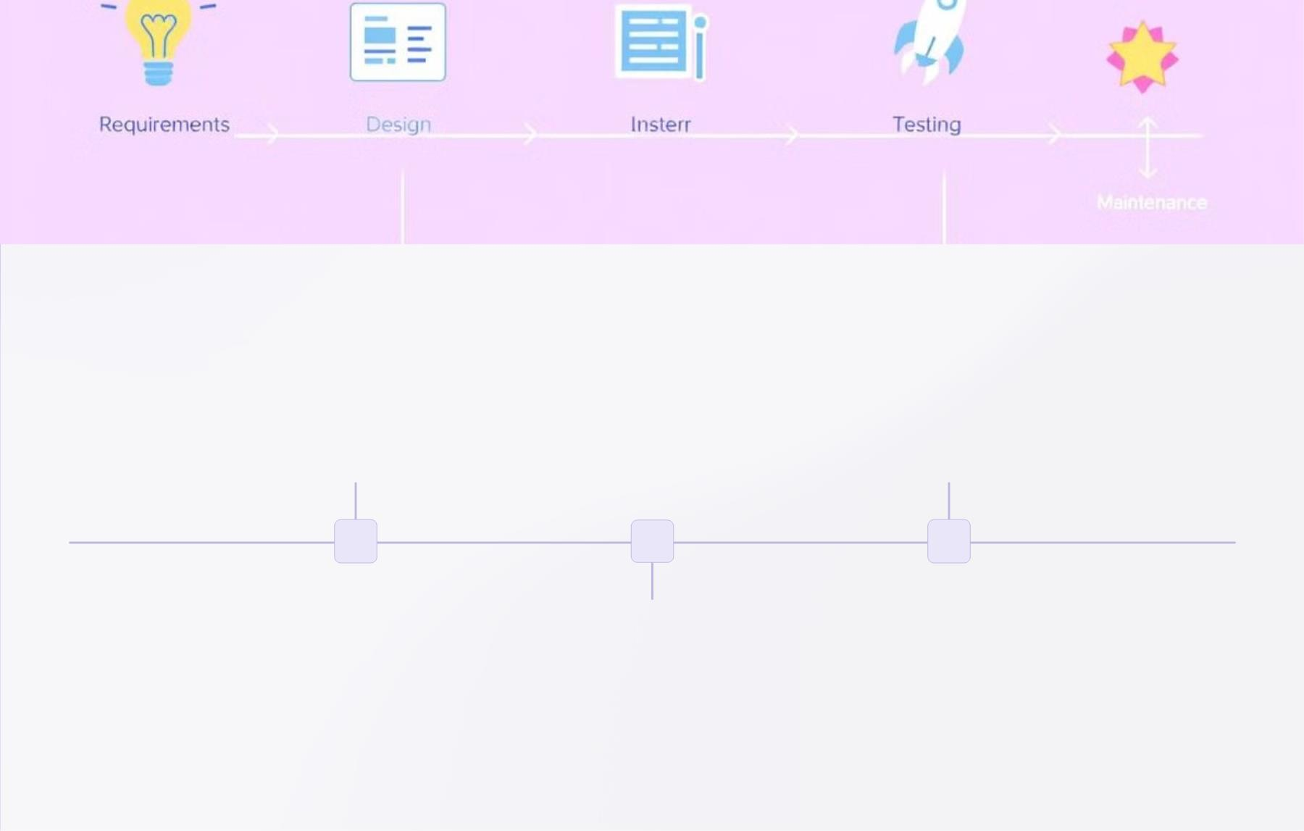
Development Roadmap
Phase 1: MVP
Phase 3: Integration
Core modules and basic matching
Corporate wellness and travel
1
2
3
Phase 2: Expansion
Advanced matching and social features
Phase 1 focuses on MVP development. Phase 2 expands features and internationalization. Phase 3 integrates enterprise solutions.
Machine learning is planned.

Slide 8
Projected Outcomes
Millions
Increased
User Connections
Sports Participation
Community
Building
Millions of user connections are projected. Increased sports participation is
expected. Community building and enhanced networking is the goal. The app
will be useful for local and travel.

Slide 9
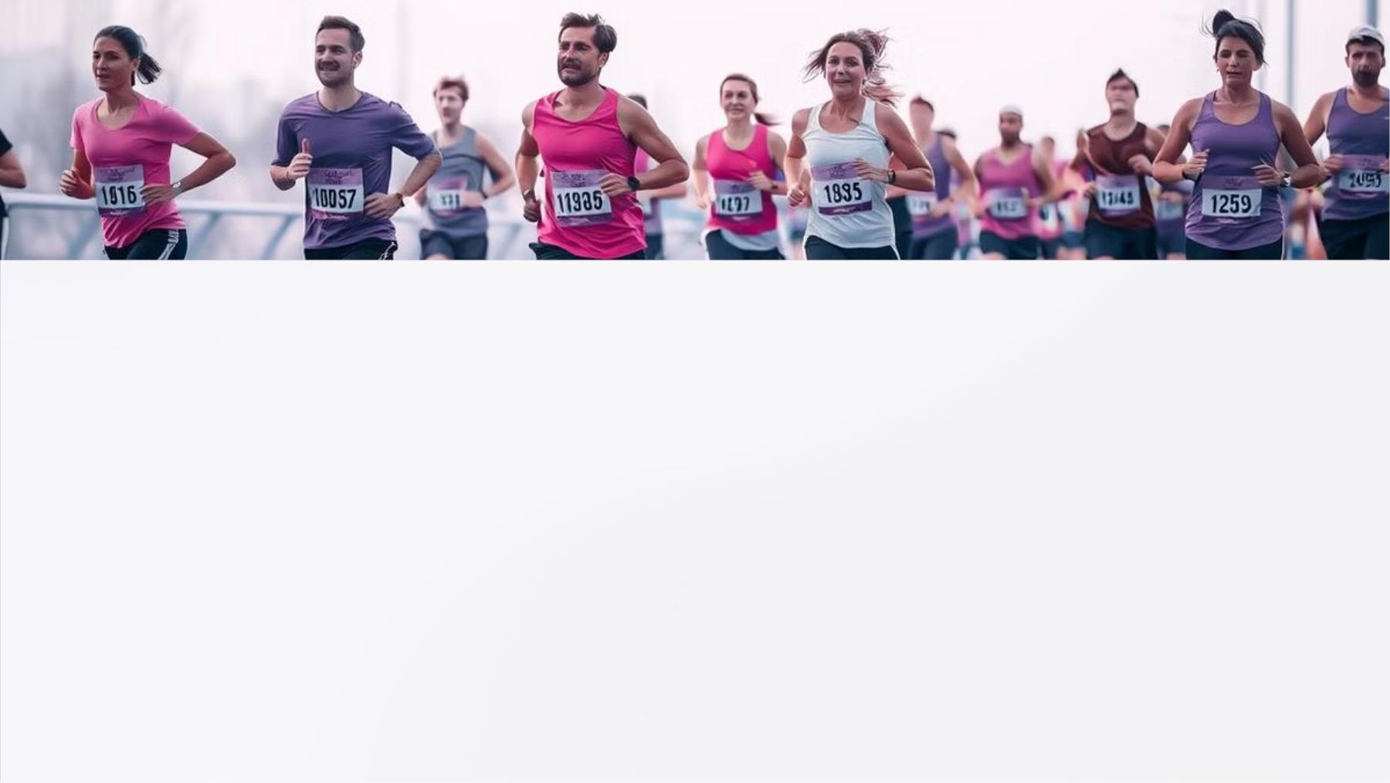
Conclusion
Sports Buddy is a new approach to event discovery. It revolutionizes social networking. It empowers users. Users connect through
shared sporting interests. The application enhances experiences.

